Slide 1

ISE 511L Final Application Project Autonomous RC Car
University of Southern California Industrial and Systems Engineering Department Presented by: Elaine Wu

Slide 2

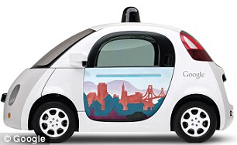
PURPOSE
Mobility and Accessibility for the Future:
Transportation for people who could not drive previously before:
Handicapped and disabled civilians
Children and senior citizens
Drivers prone to falling asleep, road rage, and other minor accidents.
People who lack driving skills overall.
Many automotive companies and OEM’s are aiming to provide driverless cars/services by 2020.
Examples include Google, Tesla, Uber, Delphi, and many more.

Slide 3
PURPOSE
Current traffic and preventable driving accidents:
Vehicle Congestion
Compact Parking
Left turns
Blind spots
Sleeping at the wheel
Right of Way
Driverless vehicles is one of the many solutions that can alleviate the common issues above.

Slide 4
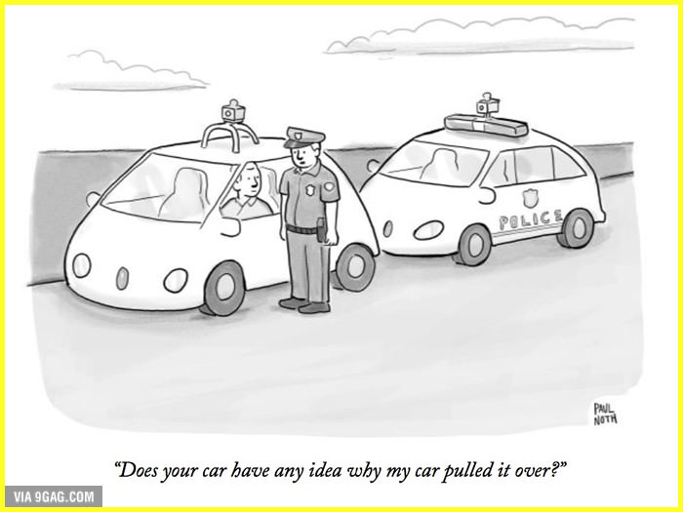
PURPOSE
Typical Causes of Driving Accidents and Driver Dissatisfaction:
Vehicle Congestion
Distracted Driving
Cell phones, multi-tasking while driving, etc.
Speeding
Driving Under the Influence (DUI)
Reckless/Careless Driving
Tailgating, rubbernecking, falling asleep at the wheel
Failure to Stop of Traffic Lights and Stop Signs
Driverless vehicles is one of the many solutions that can prevent many of the top causes for driving accidents listed above.
Notes:
http://www.freedomchannel.com/road-safety-in-2016-top-10-causes-of-car-accidents-in-the-us/

Slide 5
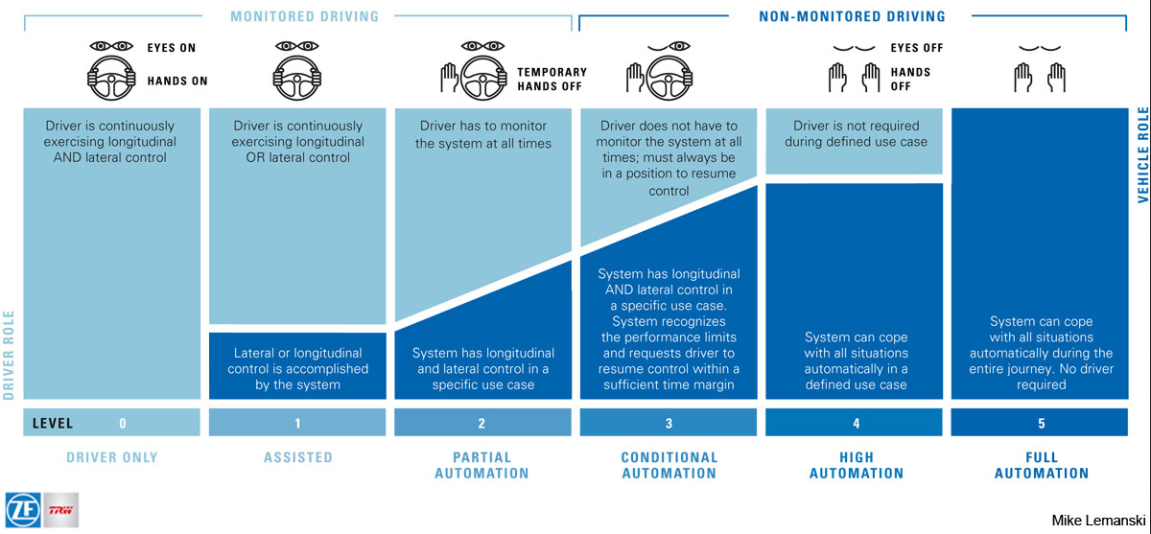
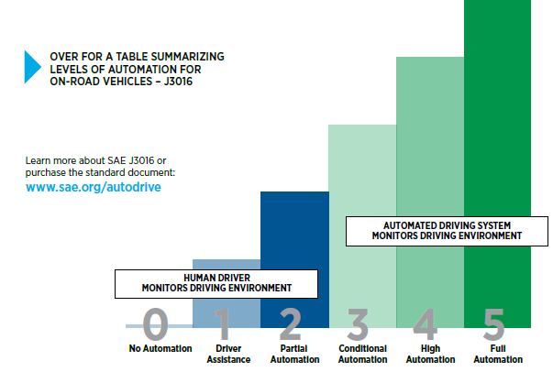
DRIVING AUTOMATION STANDARDS
SAE International Standard J32016 -- Driving Automation Levels
Total of 6 Level Definitions:
Level 0 to 2: Automation
Driver supervision highly recommended
Level 4 to 5: Autonomous
No driver supervision required
Notes:
http://safety.trw.com/wp-content/uploads/2016/01/AutomatedDriving_table_large.jpg

Slide 6

TECHNOLOGICAL ADVANCES
Commercial Advances on the Market
Future Improvements
Technology such as LIDAR, camera, and radar are combined to allow for certain level of automated control. SAE Standard J32016 Level 1 & 2 Driving Automation:
Forward Collision Avoidance
Automatic Emergency Braking
Lane Assist & Adaptive Cruise Control
Lane Detection
Automated Parking Assist
Mandated rear safety cameras in 2018
Vehicle to Vehicle (V2V) Communications
Infrastructure
Mapping and Localization
3D Mapping
V2X Communications (DSRC, 5G)
Motion Planning and Navigation, Guidance, and Control
Sensor Fusion and Visual Perception
Artificial Intelligence and Deep Learning
Obstacle Avoidance
Other Non-technical Fields: Legal, Privacy, Security, Safety
Shuttershock
Notes:
https://priceonomics.com/why-ups-trucks-dont-turn-left/
http://standards.sae.org/j3016_201609/

Slide 7
PROJECT DESCRIPTION
GOAL: Retrofit Miniature RC Car to move from point A to point B.
WHY? Simulate autonomous driving in a scaled environment.
KEY OBJECTIVES:
Avoid Obstacles
Indoor Navigation
Reach within 10cm of target
Path Optimization
Affordable Budget

Slide 8
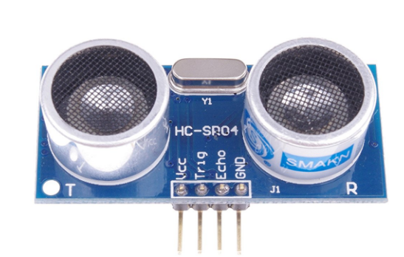
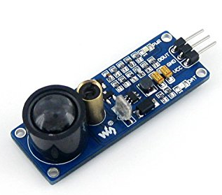
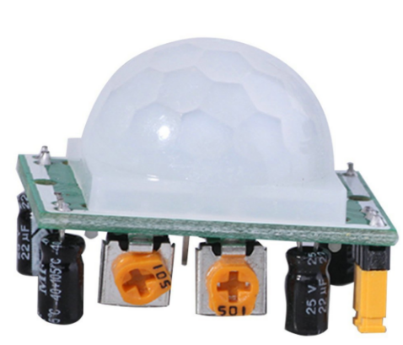
EQUIPMENT AND MATERIALS
HC-SR204 Ultrasonic Distance Sensor
Obstacle Avoidance
Sensors:
HC-SR204 Distance Sensor (3)
Left Peripheral
Front
Right Peripheral
Infrared Laser Distance Sensor
Front (Redundancy)
HC-SR501 Motion Sensors
If time permits, accommodate moving obstacles
Coded to stop when sensor is within 15cm of object/obstacle
If left and right also blocked, car reverses
Infrared Laser Distance Sensor
HC-SR501 Pyroelectic Infrared Motion Sensor

Slide 9
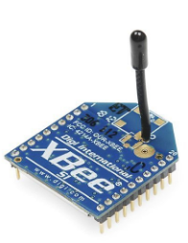
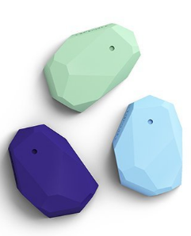
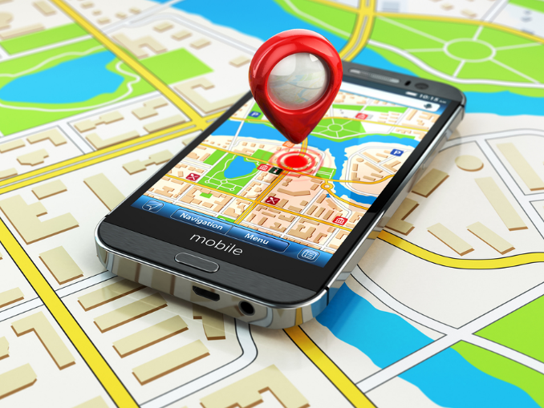
EQUIPMENT AND MATERIALS
Xbee 1mW Series 1
Indoor Navigation
Received Signal Strength Indicator (RSSI):
Xbee 802.15.4 Series 1 Modules (2)
Router located at target destination
Coordinator located on RC Car
Arduino RSSI Meter
Develop calibration module for ensuring vehicles is heading toward destination.
iBeacons
Cost
GPS for Positioning
Accuracy is limited to outdoor usage
Proximity Beacons
GPS

Slide 10
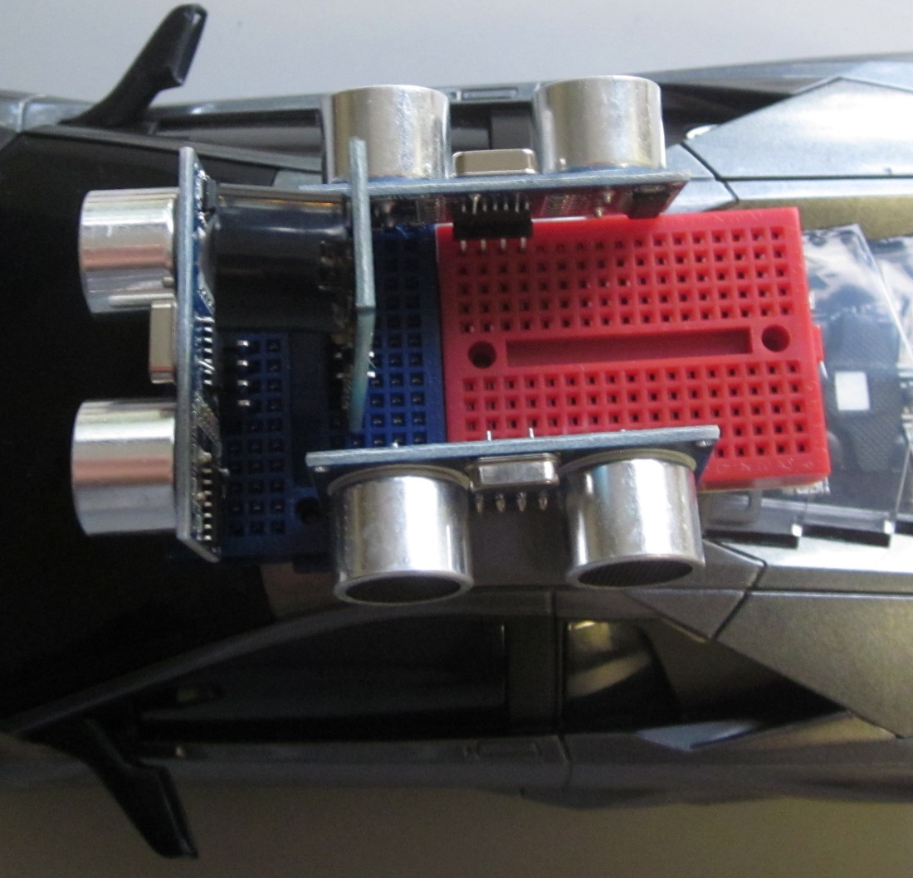
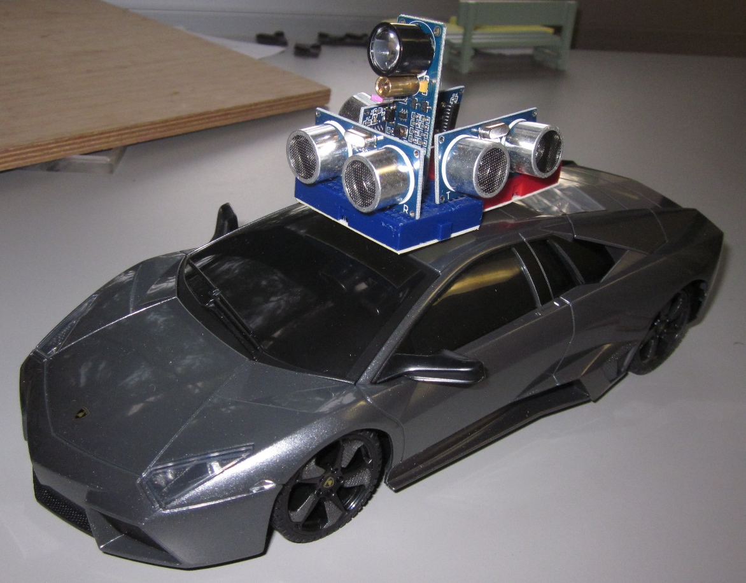
OBSTACLE AVOIDANCE
GOAL: Retrofit Miniature RC Car to move from point A to point B.
Arrangement of Devices on RC Car
Note: Wiring and Arduino Removed from picture for aesthetic purposes.

Slide 11
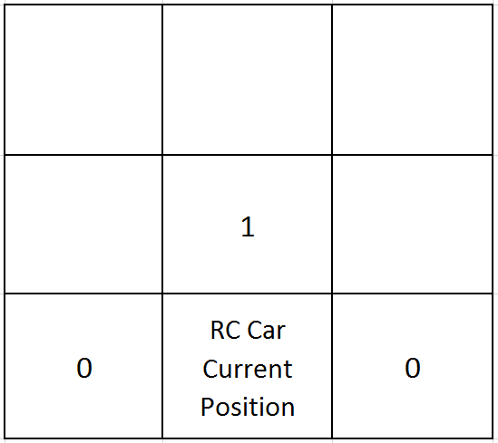
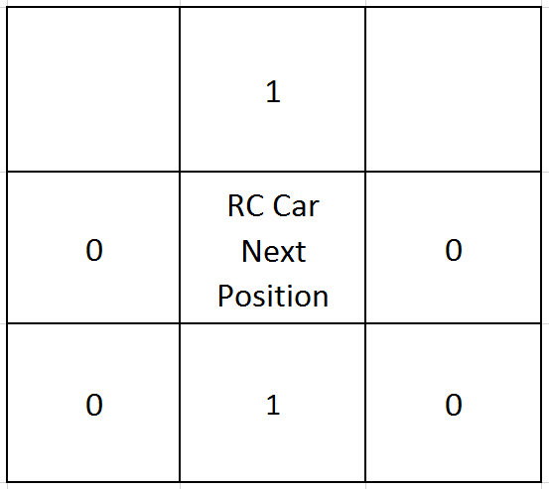
OBSTACLE AVOIDANCE
GOAL: Retrofit Miniature RC Car to move from point A to point B.
Arrangement of Devices on RC Car
Matrix of 0 and 1 for localization and mapping

Slide 12
INDOOR NAVIGATION - RSSI
GOAL: Retrofit Miniature RC Car to move from point A to point B.
RSSI operates on 802.15.4 standard wireless communication where signal strength is measured from transmitter and receiver in decibels [dB]
dB measured varies with distance from target (receiver)
Differentiates Target Navigation vs. Random Navigation
Xbee modules have a compatible Arduino library as well as an RSSI pin that outputs a PWM signal, representing this value with:
pulseIn(digitalPin, LOW, 200);

Slide 13
RSSI
GOAL: Retrofit Miniature RC Car to move from point A to point B.
RSSI measures signal logarithmically
An increase in +6dB means the signal has doubled in strength
An increase in + 12dB means the signal increased by 4 times.
Requires fine tuning to calibrate the dB at varying distances away, however that is not needed.
All that is needed is the calibrated threshold at which the RC Car is within proximity of target.

Slide 14
PROGRESS
GOAL: Retrofit Miniature RC Car to move from point A to point B.
Sensors are calibrated individually, but need to calibrate relative to each other
Need to Calibrate Threshold for Xbee RSSI Meter
Might add OSD onto Arduino to display RSSI value
Reconsidering demonstrating in the hallway rather than classroom.
Carpet
Abnormal Objects

Slide 15

THANK YOU!
The New Yorker
QUESTIONs?
Notes:
https://gigaom.com/2014/01/07/fords-connected-car-wont-deliver-a-pizza-but-it-can-order-one/

